Slide 1
SIC030 - PPT - SESI ke 1 Sistem Perdagangan Elektronik
Pengantar Perdagangan Elektronik :
Sejarah dan konsep EC
M HANIF JUSUF ST MKOM

Slide 2
Biodata
Nama : M Hanif Jusuf ST MKOM
Pekerjaan : Dosen STMIK Indonesia dan karyawan Telkomsigma
Hp/wa : 08128154967
Email : hanif26@yahoo.com

Slide 3
Background
History of the Internet
What is an Information System

Slide 4
Learning Objectives
Define electronic commerce (EC) and describe its various categories.
Describe and discuss the content and framework of EC.
Describe the major types of EC transactions.
Describe some EC business models.

Slide 5
Learning Objectives (cont.)
Describe the benefits of EC to organizations, consumers, and society.
Describe the limitations of EC.
Describe the role of the digital revolution in EC.
Describe the contribution of EC to organizations responding to environmental pressures.

Slide 6
Marks & Spencer—A New Way to Compete
The Problem
UK-based, upscale, global retailer of
high-quality, high-priced merchandise faces stiff competition, since economic slowdown that started in 1999
Critical success factors
Customer service
Appropriate store inventory system
Efficient supply chain activities

Slide 7
Marks & Spencer (cont.)
The Solution
M&S realized that digital era survival depends on the use of information technology in general and electronic commerce in particular
Electronic commerce (EC, e-commerce)—a process of buying, selling, transferring, or exchanging products, services, and/or information via electronic networks and computers

Slide 8
Marks & Spencer (cont.)
M & S initiated several EC initiatives, including:
Security
Warehouse management
Merchandise receiving
Inventory control
Speeding up the supply of fashion garments
Collaborative commerce

Slide 9
Marks & Spencer (cont.)
The Results
As of summer 2002, a turnaround is underway
M & S has become a leader and example setter in retailing, resulting in increased profitability and growth

Slide 10
Marks & Spencer (cont.)
What can we learn…
Traditional brick-and-mortar companies face increasing pressures in a competitive marketing environment
A possible response is to introduce a variety of e-commerce initiatives that can improve
supply chain operation
information
money from raw materials through factories
increase customer service
open up markets to more customers

Slide 11
Electronic Commerce: Definitions and Concepts
The Internet has emerged as a major, perhaps eventually the major, worldwide distribution channel for goods, services, managerial and professional jobs
This is profoundly changing economics, markets and industry structure, products and services and their flow, consumer segmentation, consumer values, consumer behavior, jobs, and labor markets
The impact may be even greater on societies and politics, and on the way we see the world and ourselves in it

Slide 12
Electronic Commerce: Definitions and Concepts (cont.)
E-commerce defined from the following perspectives:
Communications: delivery of goods, services, information, or payments over computer networks or any other electronic means
Commercial (trading): provides capability of buying and selling products, services, and information on the Internet and via other online services

Slide 13
Electronic Commerce: Definitions and Concepts (cont.)
Business process: doing business electronically by completing business processes over electronic networks, thereby substituting information for physical business processes
Service: a tool that addresses the desire of governments, firms, consumers, and management to cut service costs while improving the quality of customer service and increasing the speed of service delivery

Slide 14
Electronic Commerce: Definitions and Concepts (cont.)
Learning: an enabler of online training and education in schools, universities, and other organizations, including businesses
Collaborative: the framework for inter- and intraorganizational collaboration
Community: provides a gathering place for community members to learn, transact, and collaborate

Slide 15
Electronic Commerce: Definitions and Concepts (cont.)
e-business: a broader definition of EC, which includes:
buying and selling of goods and services
servicing customers
collaborating with business partners
conducting electronic transactions within an organization

Slide 16
Electronic Commerce: Definitions and Concepts (cont.)
Pure vs. Partial EC depends upon the degree of digitization (the transformation from physical to digital) of:
the product (service) sold;
the process; and for
the delivery agent (or digital intermediary)
Brick-and-Mortar organizations are old-economy organizations (corporations) that perform most of their business off-line, selling physical products by means of physical agents

Slide 17
Electronic Commerce: Definitions and Concepts (cont.)
Virtual (pure-play) organizations conduct their business activities solely online
Click-and-mortar organizations conduct some EC activities, but do their primary business in the physical world
Electronic market (e-marketplace) online marketplace where buyers and sellers meet to exchange goods, services, money, or information

Slide 18
Electronic Commerce: Definitions and Concepts (cont.)
Interorganizational information systems (IOSs) allow routine transaction processing and information flow between two or more organizations
Intraorganizational information systems enable EC activities to go on within individual organizations

Slide 19
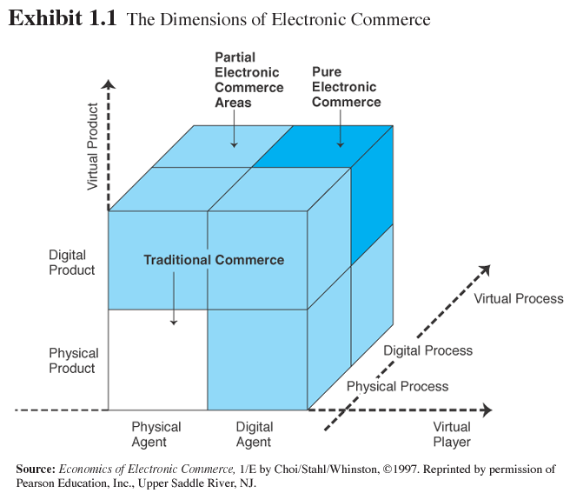
Exhibit 1.1: The Dimensions of Electronic Commerce

Slide 20
Summary
Definition of EC and description of its various categories.
The content and framework of EC.
The major types of EC transactions.
The major business models.

Slide 21
Summary (cont.)
Benefits to organizations, consumers, and society.
Limitations of EC.
The role of the digital revolution.
The role of EC in combating pressures in the business environment.

Slide 22

Selesai

